Slide 1
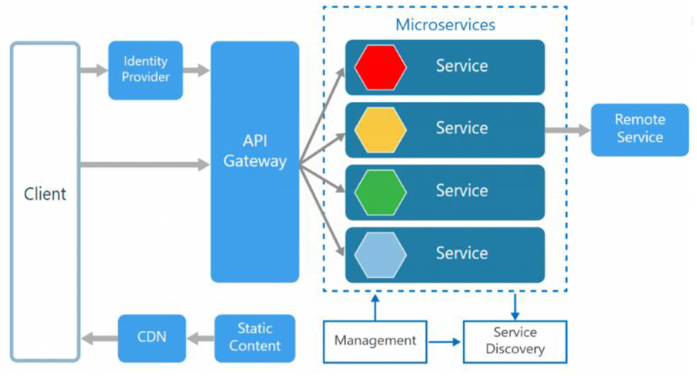
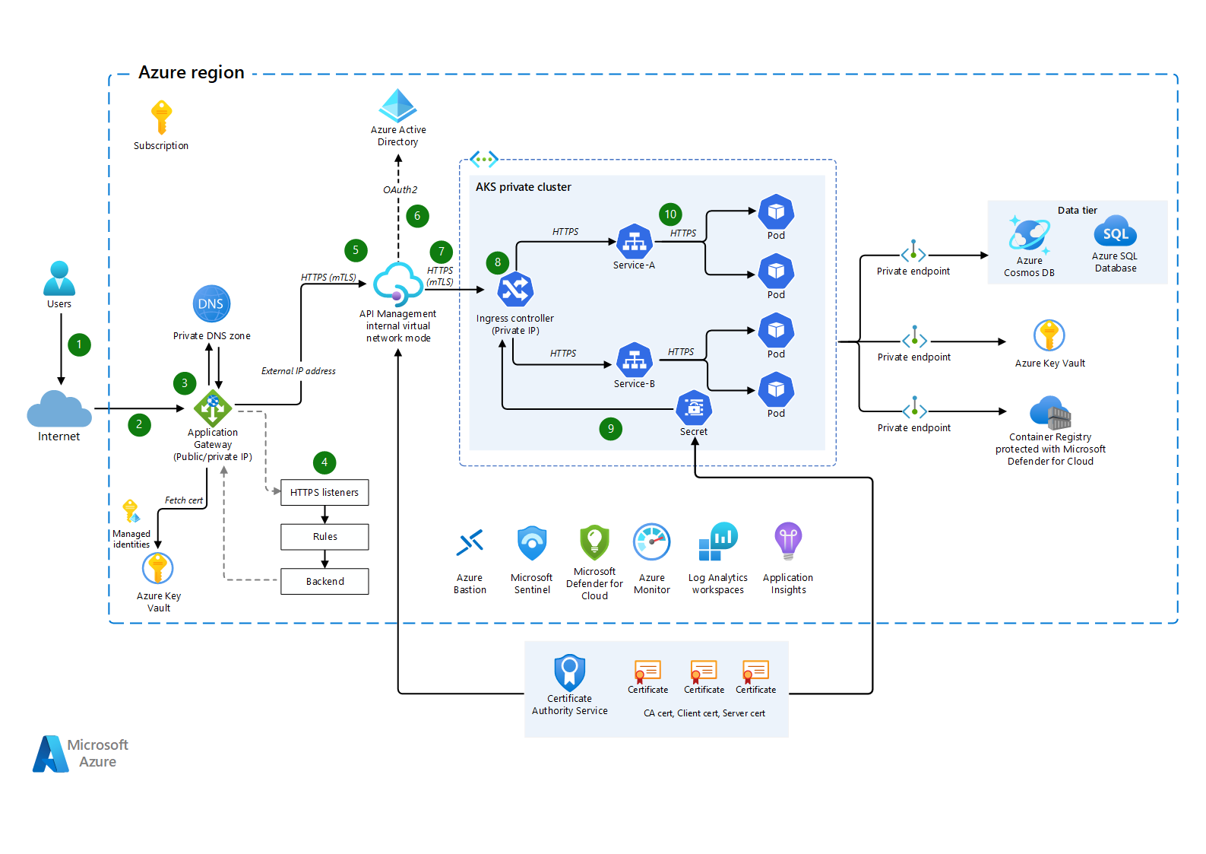
Azure .NET Microservice Project Strategy
Brief discussion about your Microservices Project Challenges, Security, communication, Monitoring, Logging, Design pattern, Web App, APIs(Microservice API) and Database (SQL, NoSQL) Communication. Backup, Disaster Recovery, Branching Strategy, Load etc. (Technical Interview - Which Azure Service and why, Which Design pattern and why)
1. High-Level Architecture Overview
2. Migration Strategy on Azure (12 Factor, 6R Strategy, Landing zone, CAF, Reference Arch..)
2. Availability and Redundancy (Azure load balancer, availability set, availability zone, Blue green deployment, AKS)
3. Scalability and Elasticity-(AKS, Auto-Scaling(VM Scaleset) DB Scalabiity (Elastic Pools), Azure CDN, Azure redis cache
4. Cost Optimization – Azure Cost tool(Report)
5. Data Storage (Azure Blob, File, Disk storage), Azure Cosmos DB, Azure SQL Database/ Azure SQL Management Instance/ Azure VM SQL
6. Security and Compliance (Azure AD, app registration, Azure APIM, log analytics, application insight, private end point, Bastion)
7. Monitoring (Health check, Azure Monitor)
8. Zero Downtime, Disaster Recovery and Backup
(VM Backup, SQL Server Backup, Replication, DB shredding, )
Distributed Caching (Azure Redis Cache),
9. Logging (File beat, Logstash, Elastic Search, Kibana) Transaction (SAGA pattern)
Use CQRS for implement
10. Common Design pattern: Abstract Factory, Mediator, Observer, CQRS, Event Source, Eventual Consistently, Retry, Circuit Breaker pattern, Database shredding,
11. Migration to Azure – (.NET application (follow SonarQube rule 95% above, code scanning done via Azure DevOps Build & Release pipeline with approval (Docker, Ubuntu Server) and deploy services on (AKS / Container app/ VM / app services)

Slide 2
Solution Architect (.Net Core + Cloud)
.Net Core 6.0, Unit testing(Sonar)
Angular, Testing
Azure Cloud Services
Design Patterns & Cloud Design Pattern
Azure cloud services
Microservices Architecture
NoSQL Databases
Solutioning
Designing
Rearchitecting (6R related)
RFP's
Cost Estimation
Landing Zone
Blueprints
Architectural design

Slide 4
Scalability Limitations
Complexity
Deployment Bottlenecks
same resources (CPU, memory, storage) for all components
Availability and Fault Tolerance:
Development and Testing Challenges:
Assessment and Planning: Scalability, cost-efficiency, disaster recovery.
Compliance:regulatory and compliance GDPR, Resource Lock, Azure Blueprint, Azure security centre, Defender
Resource Provisioning: VM, app services, Storage, CDN, Networking, Azure SQL Database, Load balancer
Migration: SQL Database Migration Wizard, Azure App Service Migration Assistant, Azure Database Migration Service, Azure Site Recovery
Application Deployment: Web APP, AKS /Container APP,
Monitor: Azure Monitor, Azure Security Center, Cost Management
Scalability and Load: Horizontal Scaling, Load balancer, Azure application gateway, Front door, Traffic manager
Security and Compliance: RBAC, Azure AD, B2C, app registration, DDOS
Backup and Disaster Recovery: Azure Backup, Azure App Service Backup, Azure Backup for SQL Server, Azure SQL Database Geo-Replication
Cost: Azure Advisor, Azure Cost Management

Slide 5
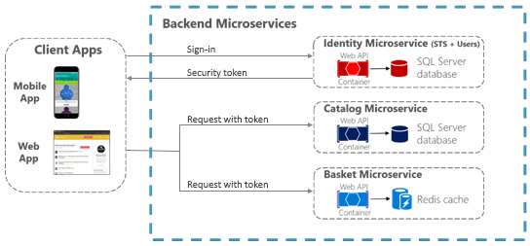
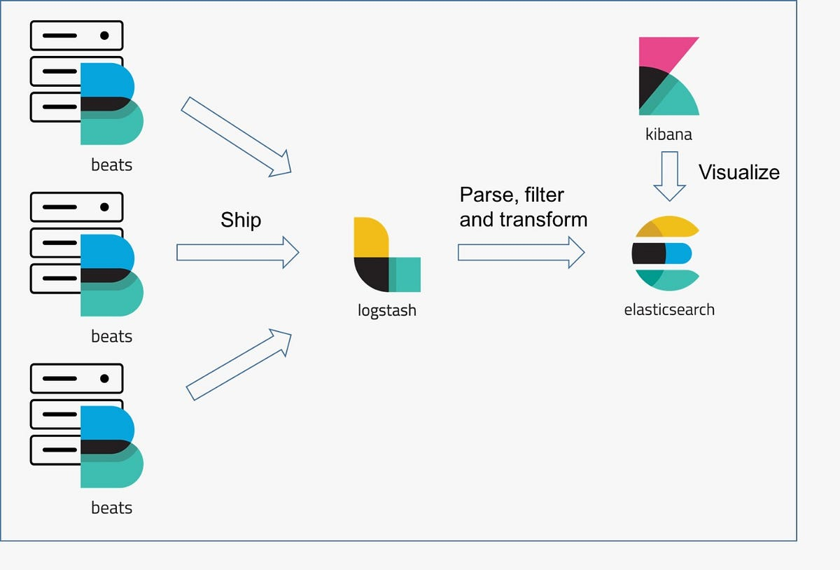
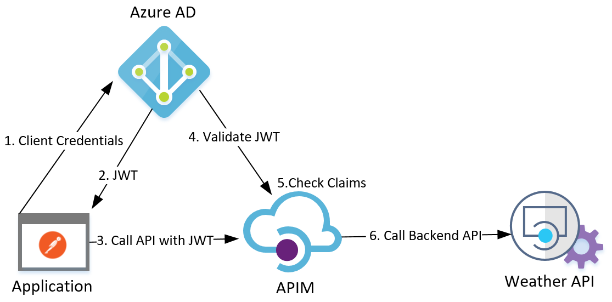
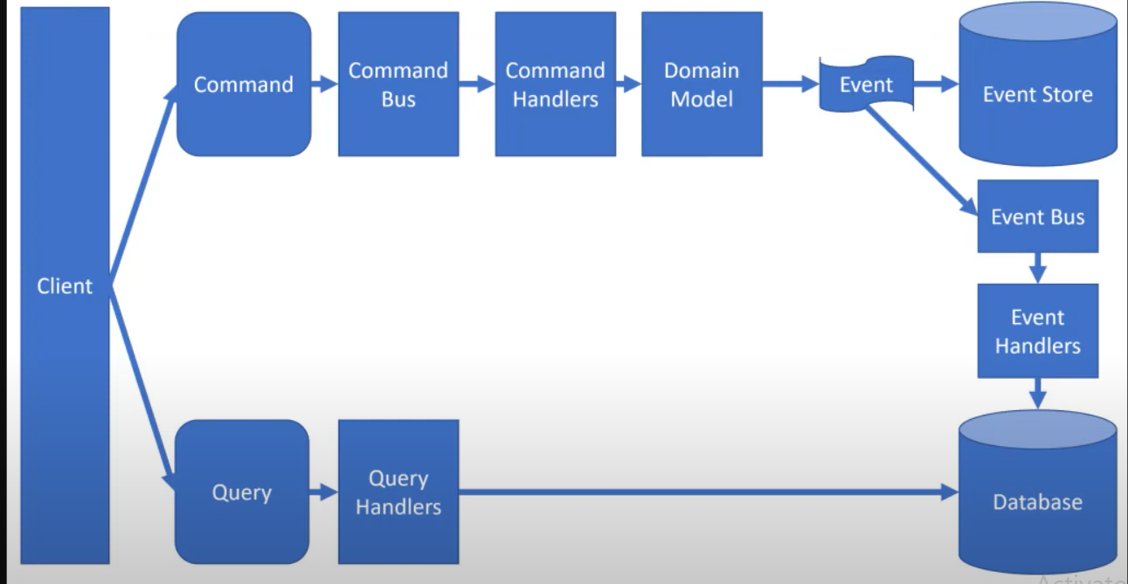
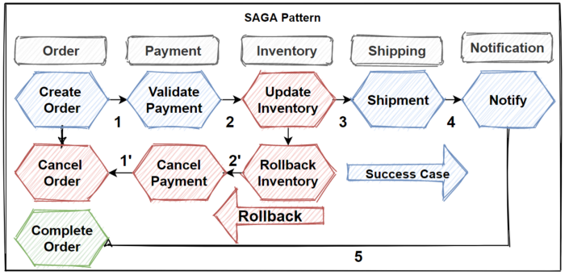

Slide 6
Common Design Principle, Pattern and Practice for Microservice Architecture
Authentication & Authorization in multiple Web API and Angular UI.
Every API choose 12 Factor Microservices, Use containerization (Docker) and orchestration (Kubernetes) for scalability and reliability.
SOLID Principle, GOF Design Pattern, Cloud Design Pattern
DDD, CQRS, Event source, Eventual Consistency, Materialized view
Database Shading Pattern for Scaling Microservices Database Architecture
2 Phase Commit, SAGA (Choreography, Orchestration), Anti pattern, Fault Tolerance, Failover, Disaster Recovery, Snapshot (VM, SQL Server)
Retry & Circuit Breaker pattern, RTO, RPO,
Azure Service- APIM, Azure Function, logic app, app Service, Azure Sql server Database, Azure Cosmos DB, Azure Storage (Blob, Queue, File, Disk)

Slide 7
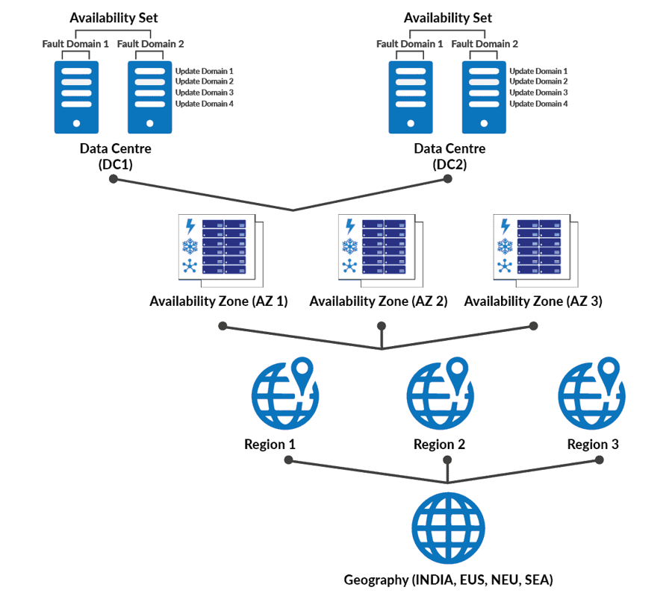
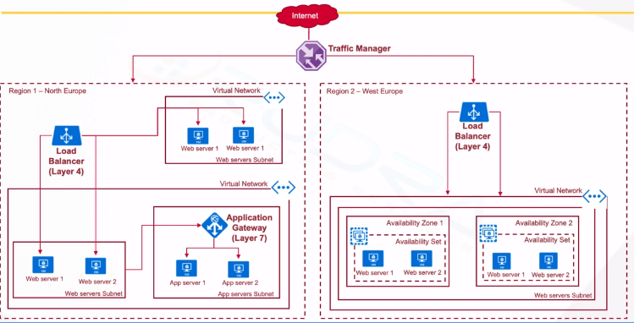
Availability and Redundancy Explain the strategies to achieve high availability and fault tolerance in the Azure architecture. Discuss the use of Azure Availability Sets, Availability Zones, and load balancing mechanisms.

Slide 8
Scalability and Elasticity Describe how the architecture will handle scalability to accommodate fluctuations in user traffic. Discuss the implementation of Azure Auto Scaling and other scaling mechanisms.
Azure Kubernetes Service (AKS)
Azure Load Balancer
Azure Application Gateway
Azure Traffic Manager
Azure Front Door
Azure CDN
Azure Redis Cache
Azure CosmosDB
Azure SQL Database, SQL Management instance, VM SQL Server
Azure Monitor, Azure Application Insight
Azure Function with Durable Entities
We should use CQRS, DDD, Retry, Circuit Breaker, Shredding pattern as Best Practices for APIs related project.

Slide 9
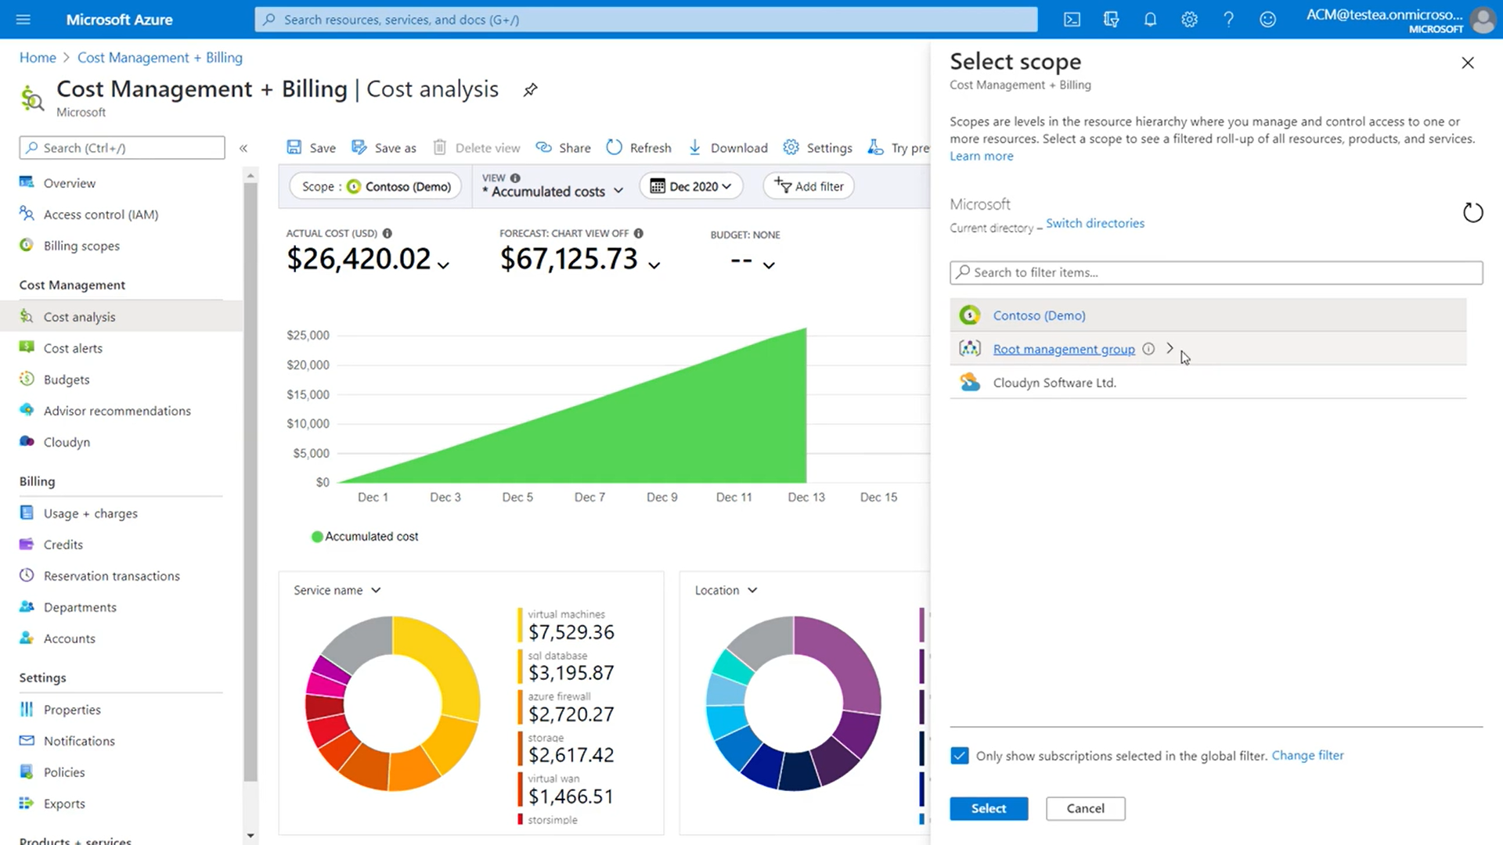
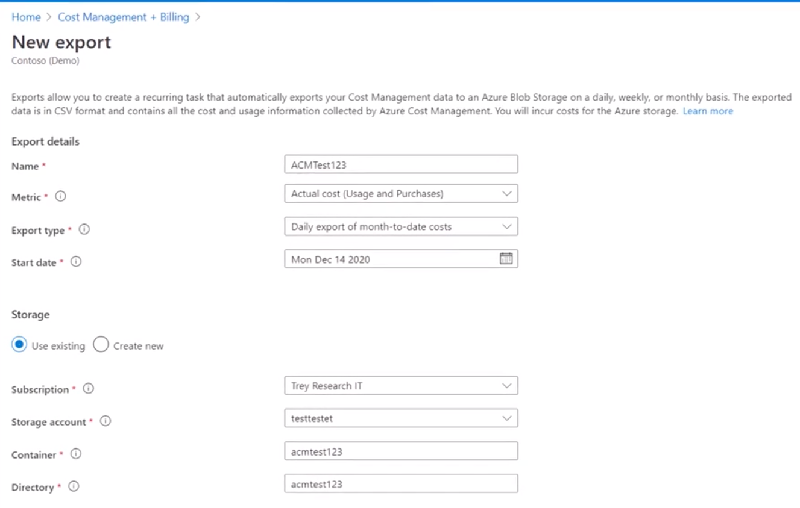
Cost Optimization Explain the use of Azure Reserved Instances, Spot Instances, and cost management tools. Azure Reserved Instances using Azure portal use tools like Azure Cost Management, and review the Azure Pricing Calculator

Slide 10
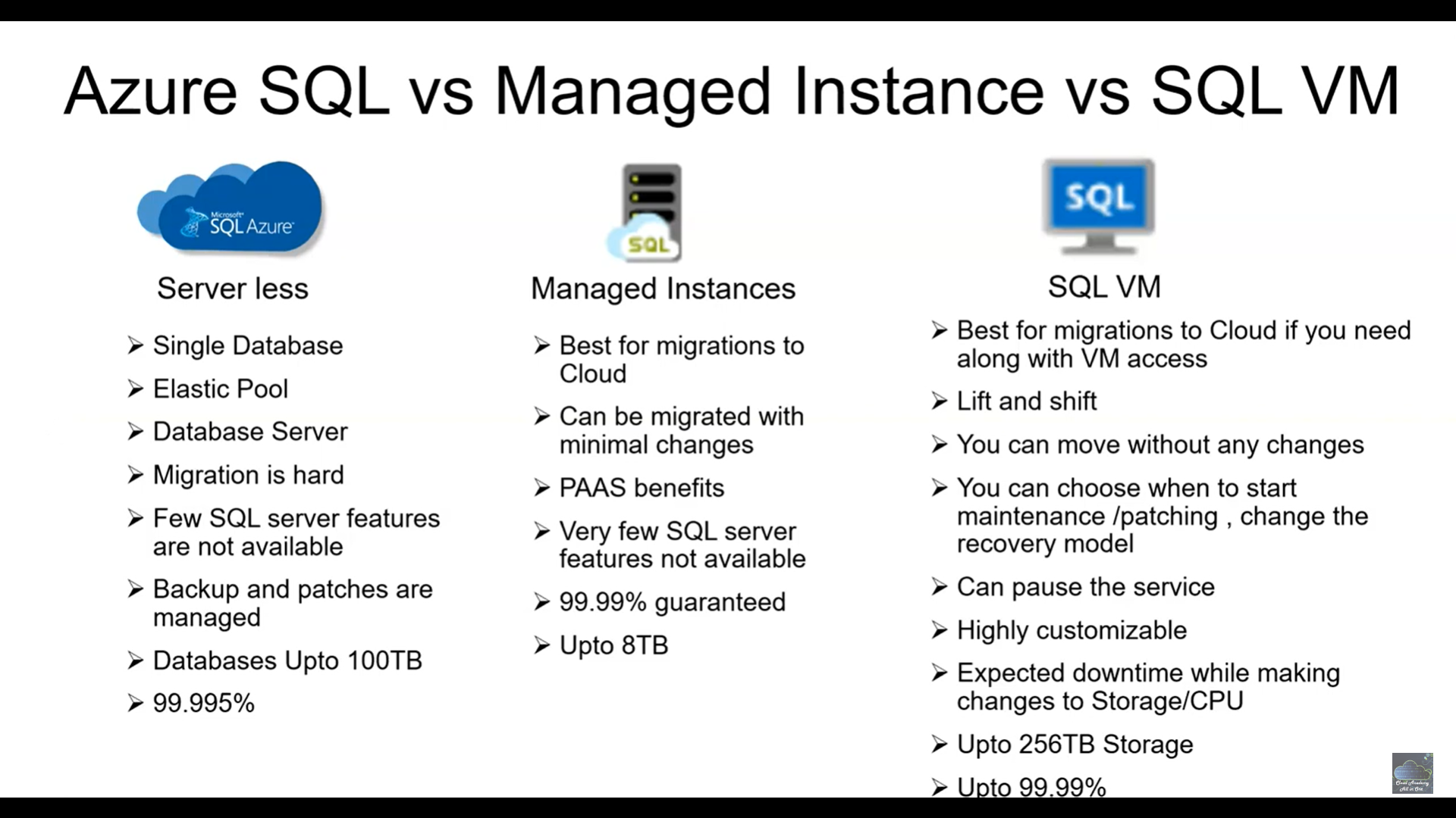
Data Management and Storage Present the design for managing data in Azure, including databases, data lakes, and backup strategies. Discuss the use of Azure SQL Database, Cosmos DB Azure Storage (Blob, File, Data, Queue, Disk)

Slide 11
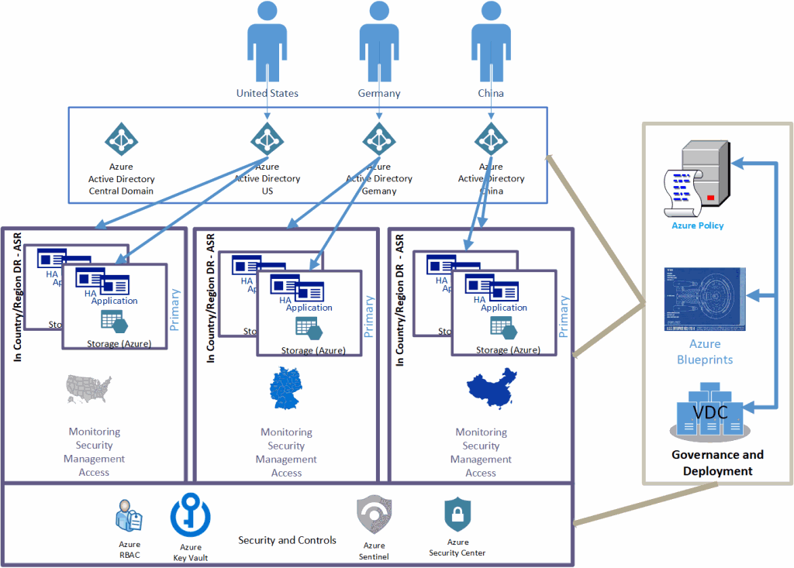
Security and Compliance Highlight the security measures in place to protect the platform's data and resources. Discuss Azure Network Security Groups, Azure Key Vault, and compliance with relevant regulations.
Azure AD, B2C (User, Role, Group)
Azure Sentinel (SEIM, SOAR Solution)
Azure Key Vault
Azure Security Center
Azure Policy
Azure Site Recovery (ASR)
Private End Point
Azure Bastion

Slide 12
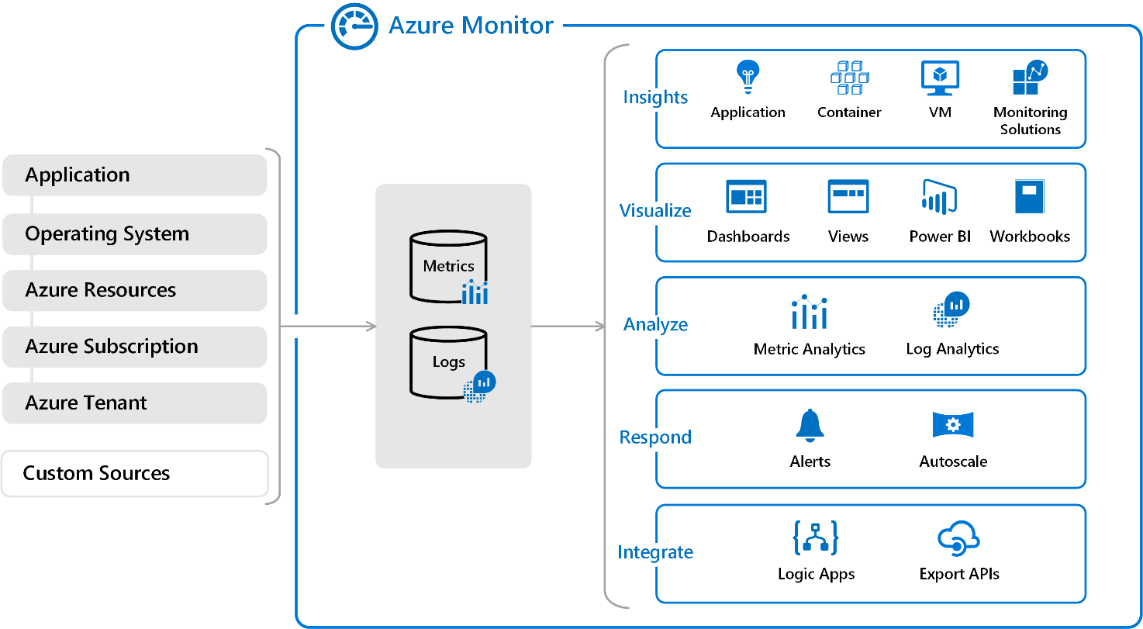
Monitoring and Performance Management Explain the monitoring and performance management solutions for the Azure architecture. Include insights on Azure Monitor, Application Insights, and performance optimization techniques.

Slide 13
Disaster Recovery and Backup Describe the disaster recovery plan to ensure business continuity. Discuss the use of Azure Site Recovery and backup mechanisms for critical data.
Key Features and Capabilities
Replication to Azure: It provides businesses with the ability to replicate their critical workloads and data to Azure, which serves as a secondary data center for disaster recovery.
Automated Failover: It provides businesses with automated failover capabilities that ensure that critical workloads and data are always available in the event of a disaster.
Testing and Validation: It provides businesses with the ability to test and validate their disaster recovery plans before a disaster occurs. This ensures that businesses are prepared and can quickly recover in the event of a disaster.
Multi-VM Application Consistency: It provides businesses with the ability to replicate multi-VM applications and ensure that they are recovered in a consistent state.
Application-level Recovery: It provides businesses with the ability to recover critical applications, including SQL Server, SharePoint, and Exchange, in a matter of minutes.
Azure BluePrint
Azure landing zone
Azure load Balancer, front door, application gateway, traffic manager (manage load on multiple Availability set/ Availability Zone)
AKS (Pod up & down)
VM (Full Backup, Daily backup)
Replication

